Slide 1
TASK-8 Implement Auto-Scaling Policies for Microservices done by O.Varaprasad

Slide 2
Auto-scaling introduction:
A characteristic of cloud computing called auto scaling automatically modifies the quantity of processing resources in response to shifting workloads.
By scaling resources up or down according to predetermined factors like CPU use, network traffic, or other indicators, it enables systems to effectively accommodate variations in demand.
This ensures optimal performance, cost-effectiveness, and reliability without manual intervention, enabling organizations to adapt to varying workload demands in their cloud infrastructure seamlessly.
Importance of Auto Scaling:
Auto Scaling is crucial for several reasons:
Optimized Performance: Without compromising speed, auto scaling makes sure your system can manage fluctuating workloads or traffic volumes.
Cost Efficiency: By dynamically scaling resources up when demand rises and down during times of low demand, it helps in cost optimization.
Improved Reliability: By distributing workloads among several instances or servers, auto scaling lowers the possibility of system outages or malfunctions.
Scalability: With auto scaling, you can easily manage unexpected increases in workload or abrupt spikes in traffic by allowing your system to grow or shrink elastically in response to demand.

Slide 3
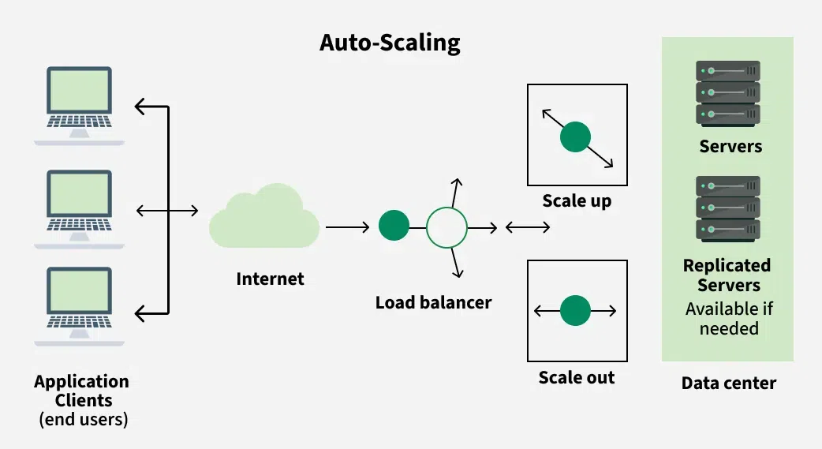
Auto-scaling Architecture

Slide 4
Two types of scaling
Horizontal and Vertical scaling
Horizontal scaling:
The increasing or decreasing the number of VM instances. It auto-scales horizontally and sometimes called as Scale-out or Scale in scaling.
Vertical scaling:
In this, we keep the same numbers of VMs but make VM more or less powerful. Power is measured as memory, CPU speed, disk space, etc. It is limited by the availability of larger hardware within the same region and usually requires a VM to start and stop. This is sometimes called Scale up or scale downscaling. Below are the steps to achieve vertical scaling.
Setup Azure automation account
Import the Azure Automation Vertical scale runbooks into our subscriptions.
Add a webhook to our network.
Add an alert to our Virtual Machine.

Slide 5
Key Components of Auto Scaling:
Launch Configuration: This sets the guidelines for the instances that Auto Scaling will launch. It includes details like the Amazon Machine Image (AMI), instance type, key pair, security groups, and block device mapping.
Auto Scaling Groups (ASG): ASGs are groups of instances that Auto Scaling manages together. They specify the minimum, maximum, and desired number of instances, along with the scaling policies that dictate how to adjust the number of instances.
Scaling Policies: These rules determine when and how Auto Scaling should add or remove instances in an ASG based on certain metrics, such as CPU usage, network traffic, or custom metrics from CloudWatch.
Scaling Cooldowns: Cooldown periods help prevent sudden changes in the number of instances by imposing a waiting period between scaling actions. This stabilizes the system and minimizes unnecessary adjustments.
Health Checks: Auto Scaling conducts health checks on instances to make sure they are operating correctly. If an instance fails a health check, it is terminated and replaced with a functioning one.

Slide 6
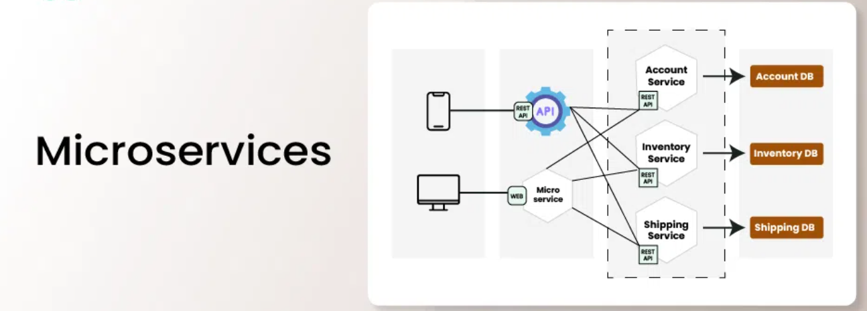
What are Microservices?
Microservices are an architectural approach to developing software applications as a collection of small, independent services that communicate with each other over a network. Instead of building a monolithic application where all the functionality is tightly integrated into a single codebase, microservices break down the application into smaller, loosely coupled services.

Slide 7
How do Microservices work?
Microservices break complex applications into smaller, independent services that work together, enhancing scalability, and maintenance. Below is how microservixes work:
Applications are divided into self-contained services, each focused on a specific function, simplifying development and maintenance.
Each microservice handles a particular business feature, like user authentication or product management, allowing for specialized development.
Services interact via APIs, facilitating standardized information exchange and integration.
Different technologies can be used for each service, enabling teams to select the best tools for their needs.
Microservices can be updated independently, reducing risks during changes and enhancing system resilience.

Slide 8
Awscli:
AWS CLI (Amazon Web Services Command Line Interface) is a unified tool provided by Amazon Web Services (AWS) to manage AWS services and resources from the command line. It allows users to interact with AWS services directly through their terminal or command prompt, providing a powerful alternative to the AWS Management Console for performing various tasks.
Key Features of AWS CLI:
Command-Line Access:
AWS CLI provides command-line tools for managing and interacting with various AWS services such as EC2 (Elastic Compute Cloud), S3 (Simple Storage Service), IAM (Identity and Access Management), Lambda, and more.
Automation:
It helps automate AWS service management by scripting commands and integrating AWS actions into CI/CD pipelines. For example, you can create, manage, and terminate instances, upload files to S3, or manage IAM users and policies—all using simple CLI commands.
Cross-Platform:
AWS CLI is available for multiple platforms, including macOS, Linux, and Windows, making it widely accessible.

Slide 9
EKS(ELASTIC KUBERNETES SERVICE)
Amazon EKS (Elastic Kubernetes Service) is a fully managed service by AWS (Amazon Web Services) that makes it easy to run Kubernetes clusters on AWS without needing to install and operate your own Kubernetes control plane or nodes. EKS handles tasks like the provisioning, management, and scaling of Kubernetes clusters, making it easier to focus on deploying and managing containerized applications.
Key Features of Amazon EKS:
Fully Managed Kubernetes Control Plane: EKS automatically manages the Kubernetes control plane, including the API server, etcd (the key-value store), and scheduler. This means you don’t have to worry about setting up or maintaining the Kubernetes master nodes.
Highly Available and Scalable: EKS is designed to be highly available, with automatic distribution of the control plane across multiple availability zones (AZs). It also supports scaling, allowing you to easily add or remove worker nodes to match your application’s needs.
Integration with AWS Services: EKS integrates seamlessly with a wide range of AWS services, including:
IAM (Identity and Access Management) for secure authentication and authorization.
ELB (Elastic Load Balancer) for load balancing across your pods.
ECR (Elastic Container Registry) for storing Docker container images.
CloudWatch for monitoring logs and metrics.
Auto Scaling to dynamically scale your node groups based on resource requirements.

Slide 10
EKS cluster:-
Amazon Elastic Kubernetes Service (EKS) is a cloud-based container management service that natively integrates with Kubernetes to deploy applications. The EKS service automatically manages and scales clusters of infrastructure resources on AWS with Kubernetes.
EKS cluster can be created in following ways:
1. AWS console
2. AWS CLI
3. eksctl command

Slide 11
Control Plane:- Amazon EKS ensures every cluster has its own unique Kubernetes control plane. This design keeps each cluster’s infrastructure separate, with no overlaps between clusters or AWS accounts. Control Plane Managed by EKS, it consists of Kubernetes API server nodes and an etcd cluster. Worker Nodes:- Worker nodes in EKS are the EC2 instances that run the Kubernetes Pods. A Pod is the smallest deployable unit in Kubernetes and can contain one or more containers. These nodes are part of the EKS Cluster and communicate with the control plane to receive instructions on which containers to run and where to run them.

Slide 12
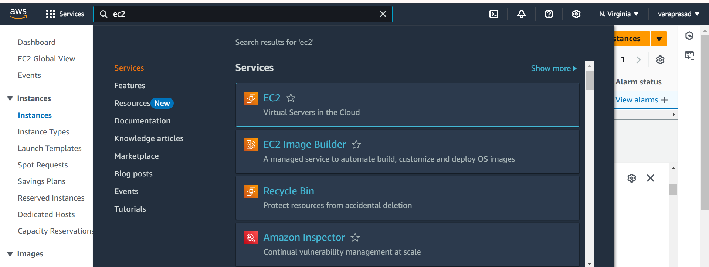
installing and Set Up EKS Cluster on AWS EC2:-​
1. AWS Account:​
Sign up for an AWS account: If you don’t already have one, create an AWS account at aws.amazon.com.​
2. AWS EC2 Instance:​
Launch an EC2 instance:​

Slide 13
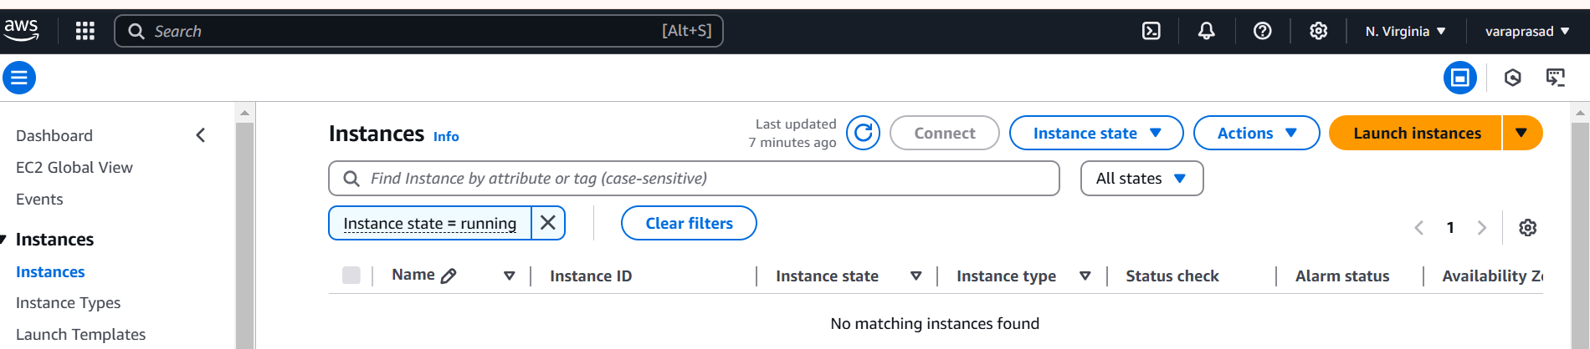
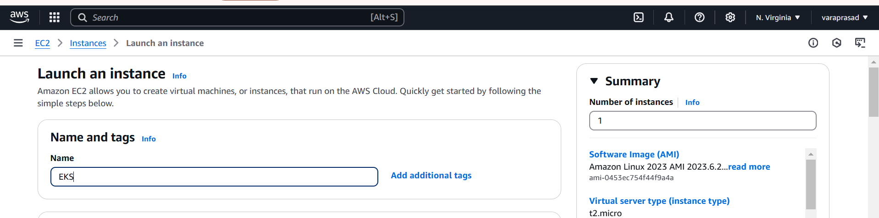
Next click on launch instance
Give to the name and tags and give name (any)

Slide 14
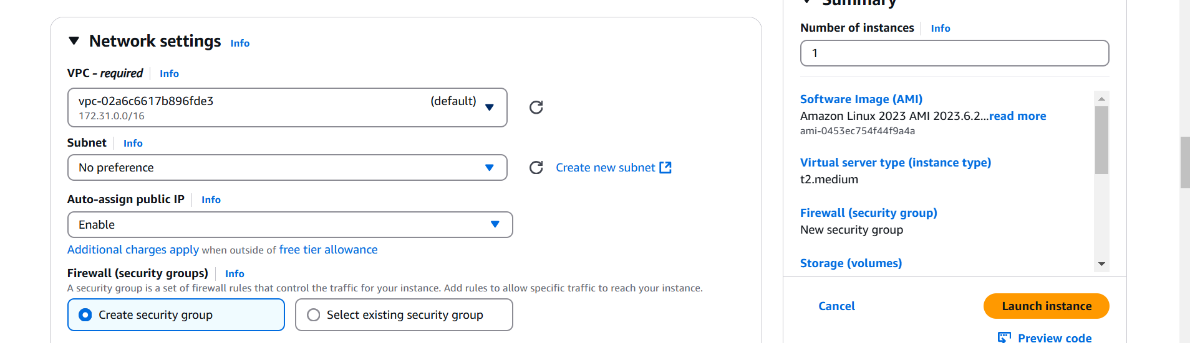
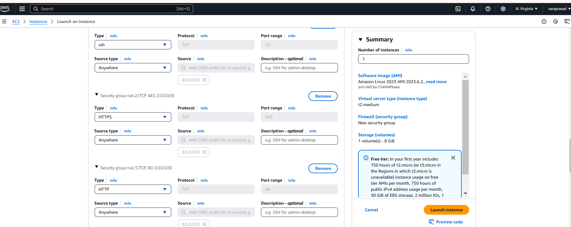
Security Group: network settings edit the auto-assign public IP as Enable. and then Allow the HTTP & HTTPS then click on Edit then add security group with All TCP then All traffic click on Launch Instance.​

Slide 15
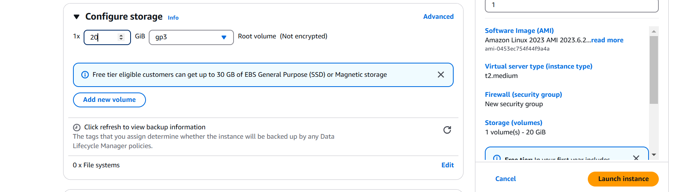
configure storage : 20 gb
And after launch instance​

Slide 16
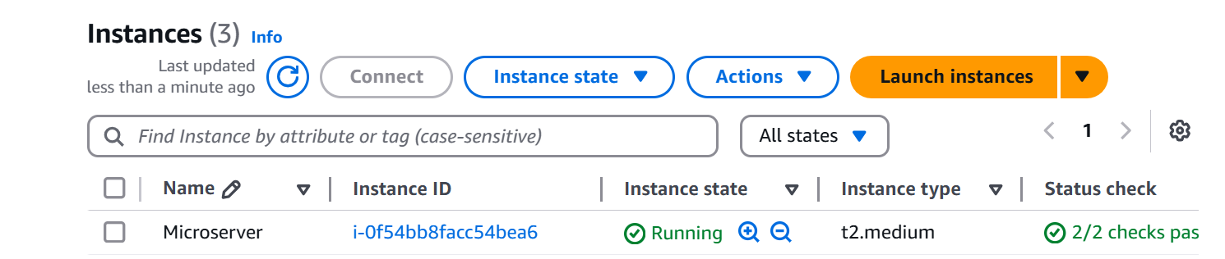
Instance Creation:- ec2 instance has been created using Ubuntu its shown below and connect the instance to git bash Install the necessary tools in gitbash like Install the Jenkins :- Change Host Name to Jenkins sudo hostname jenkins Perform update first sudo apt update

Slide 17
Install Java 11 sudo apt install default-jdk –y Verify Java Version java -version Install Maven sudo apt install maven -y you can type mvn --version you should see the below output. Now lets start the Jenkins installation Add Repository key to the system curl -fsSL https://pkg.jenkins.io/debian/jenkins.io-2023.key | sudo tee \ /usr/share/keyrings/jenkins-keyring.asc > /dev/null Append debian package repo address to the system echo deb [signed-by=/usr/share/keyrings/jenkins-keyring.asc] \ https://pkg.jenkins.io/debian binary/ | sudo tee \ /etc/apt/sources.list.d/jenkins.list > /dev/null

Slide 18
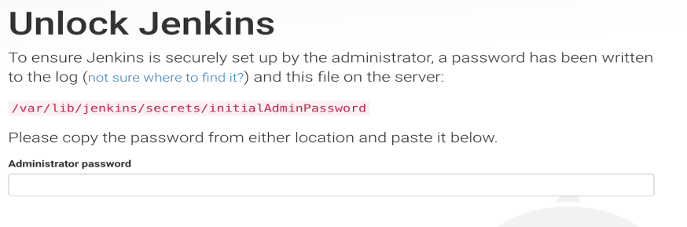
Update Ubuntu package sudo apt update Install Jenkins sudo apt install jenkins -y Access Jenkins in web browser Now copy the public ID with the Jenkins port no 8080 and paste the ID in Google to access the Jenkins Dashboard To get the initial password from the below file sudo cat /var/lib/jenkins/secrets/initialAdminPassword

Slide 19
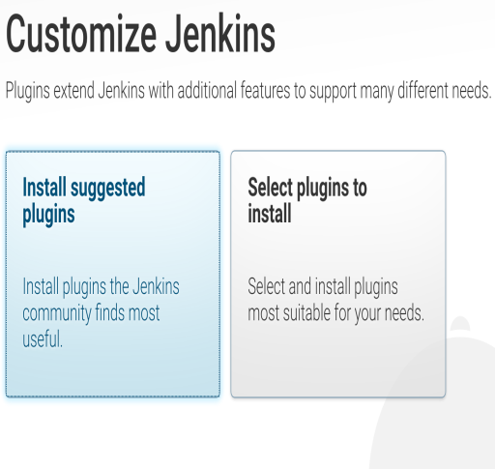
Copy the password and paste in the browser Then click on install suggested plug-ins. Also create user name and password. enter everything as admin. at least user name as admin password as admin Now Install AWS CLI:- curl "https://awscli.amazonaws.com/awscli-exe-linux-x86_64.zip" -o "awscliv2.zip" sudo apt install unzip

Slide 20

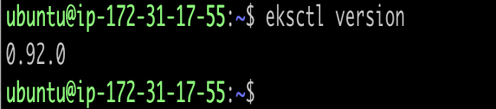
sudo unzip awscliv2.zip sudo ./aws/install aws –version Now Install Install eksctl:- Download and extract the latest release of eksctl with the following command. curl --silent --location "https://github.com/weaveworks/eksctl/releases/latest/download/eksctl_$(uname -s)_amd64.tar.gz" | tar xz -C /tmp Move the extracted binary to /usr/local/bin. sudo mv /tmp/eksctl /usr/local/bin eksctl version

Slide 21
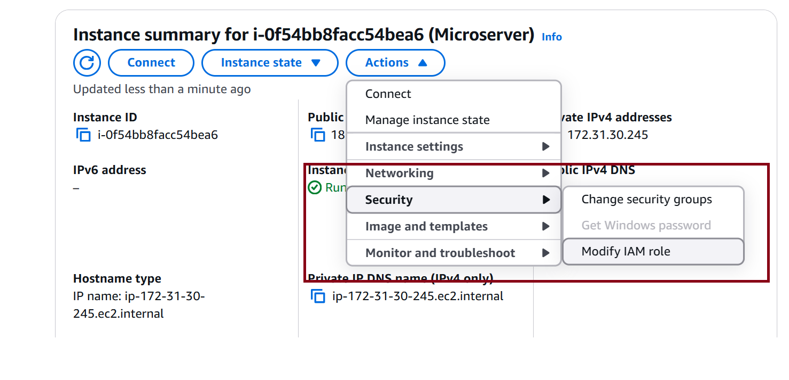
Now Install kubectl on Ubuntu Instance:- Kubernetes uses a command line utility called kubectl for communicating with the cluster API server. It is tool for controlling Kubernetes clusters sudo curl --silent --location -o /usr/local/bin/kubectl https://s3.us-west-2.amazonaws.com/amazon-eks/1.22.6/2022-03-09/bin/linux/amd64/kubectl sudo chmod +x /usr/local/bin/kubectl Verify if kubectl got installed kubectl version --short –client → Now Create IAM Role and Attach it to the running Instance

Slide 22
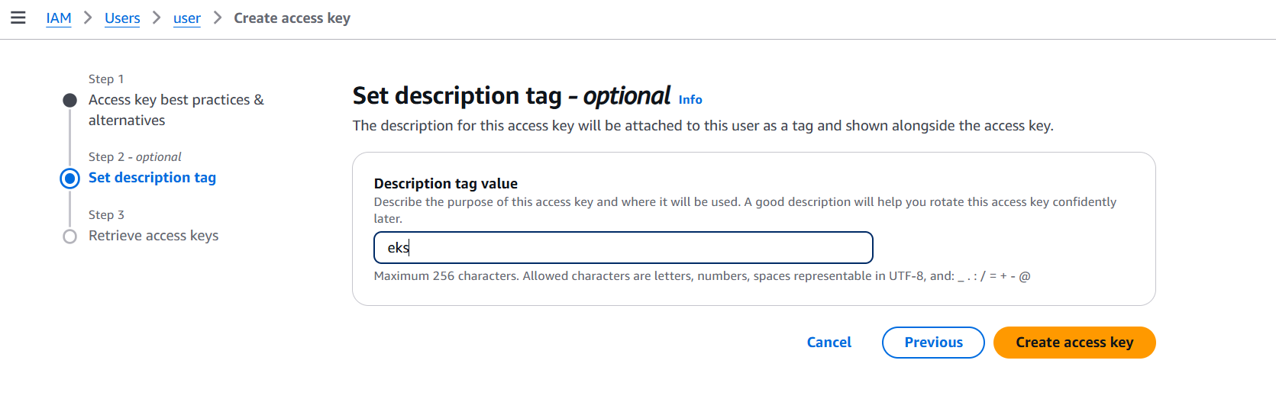
Create access key
After create a access key
Configure AWS CLI on gitbash give credentials:
Follow the below process
aws configure
AWS access key: paste the first access key
AWS secret access key: paste the first secret access key
Default region name: give region where ec2 instance created
Default output format [None]: enter

Slide 23
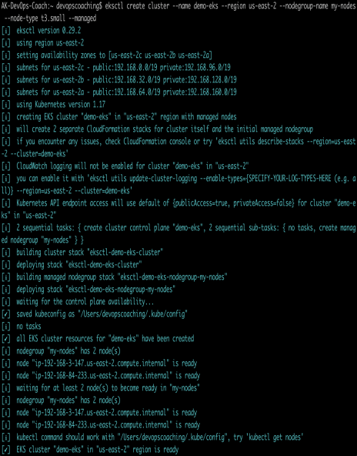
Now switch to Jenkins user → sudo su – Jenkins Now create EKS Cluster with two worker nodes using eksctl command eksctl create cluster --name demo-eks --region us-east-1 --nodegroup-name my-nodes --node-type t3.small --managed --nodes 2 the above command should create a EKS cluster in AWS it might take 15 to 20 mins. The eksctl tool uses CloudFormation under the hood, creating one stack for the EKS master control plane and another stack for the worker nodes.

Slide 24
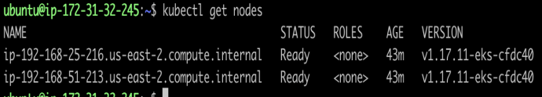
eksctl get cluster --name demo-eks --region us-east-1 This should confirm that EKS cluster is up and running. Update Kube config by entering below command: aws eks update-kubeconfig --name demo-eks --region us-east-1 kubeconfig file be updated under /var/lib/jenkins/.kube folder. you can view the kubeconfig file by entering the below command: cat /var/lib/jenkins/.kube/config Connect to EKS cluster using kubectl commands To view the list of worker nodes as part of EKS cluster. kubectl get nodes

Slide 25
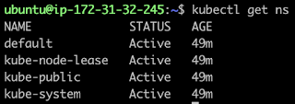
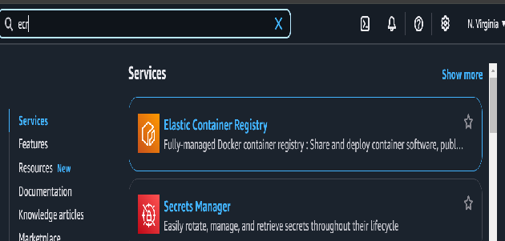
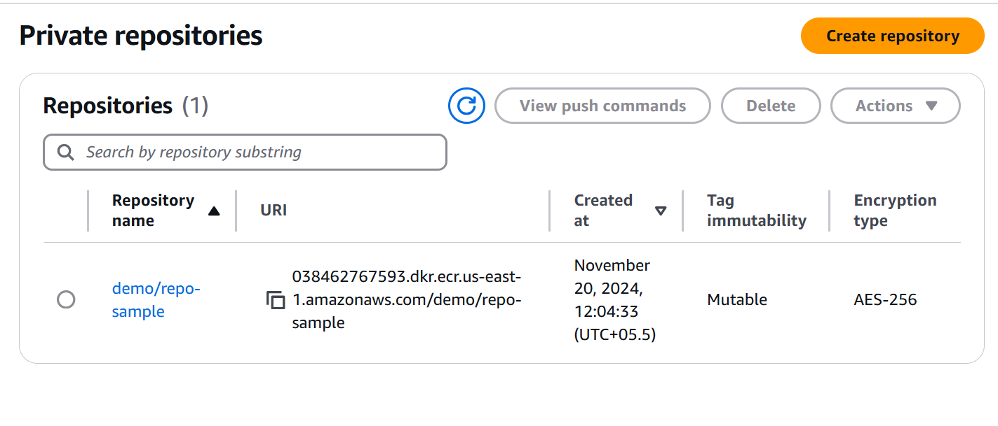
kubectl get ns Now Create repo in ecr:- Search for ECR in amazon console Create the repository and copy the URL

Slide 26
Now install Docker:- Docker installation steps using default repository from Ubuntu Update local packages by executing below command: →sudo apt update Install the below packages →sudo apt install gnupg2 pass -y gnupg2 is tool for secure communication and data storage. It can be used to encrypt data and to create digital signatures Install docker →sudo apt install docker.io -y Add Ubuntu user to Docker group →sudo usermod -aG docker $USER We need to reload shell in order to have new group settings applied. Now you need to logout and log back in command line or execute the below command: →newgrp docker

Slide 27
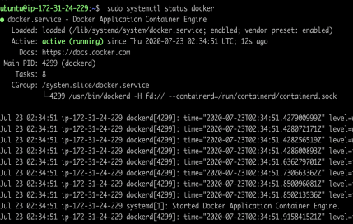
The Docker service needs to be setup to run at startup. To do so, type in each command followed by enter: sudo systemctl start docker sudo systemctl enable docker sudo systemctl status docker Docker Jenkins Integration | Building Docker Images using Jenkins - Every time developer makes code changes, you would want to Jenkins to automate Docker images creation and pushing into Docker registry.

Slide 28
Pre-requisites: Jenkins is up and running Docker is installed in Jenkins machine Install necessary plugins in Jenkins machine Docker plugin installed in Jenkins. Docker pipeline plugin installed in Jenkins. Kubernetes CLI plugin installed in Jenkins Now Login to Jenkins EC2 instance, execute below commands: Add jenkins user to Docker group →sudo usermod -a -G docker jenkins Restart Jenkins service →sudo service jenkins restart

Slide 29
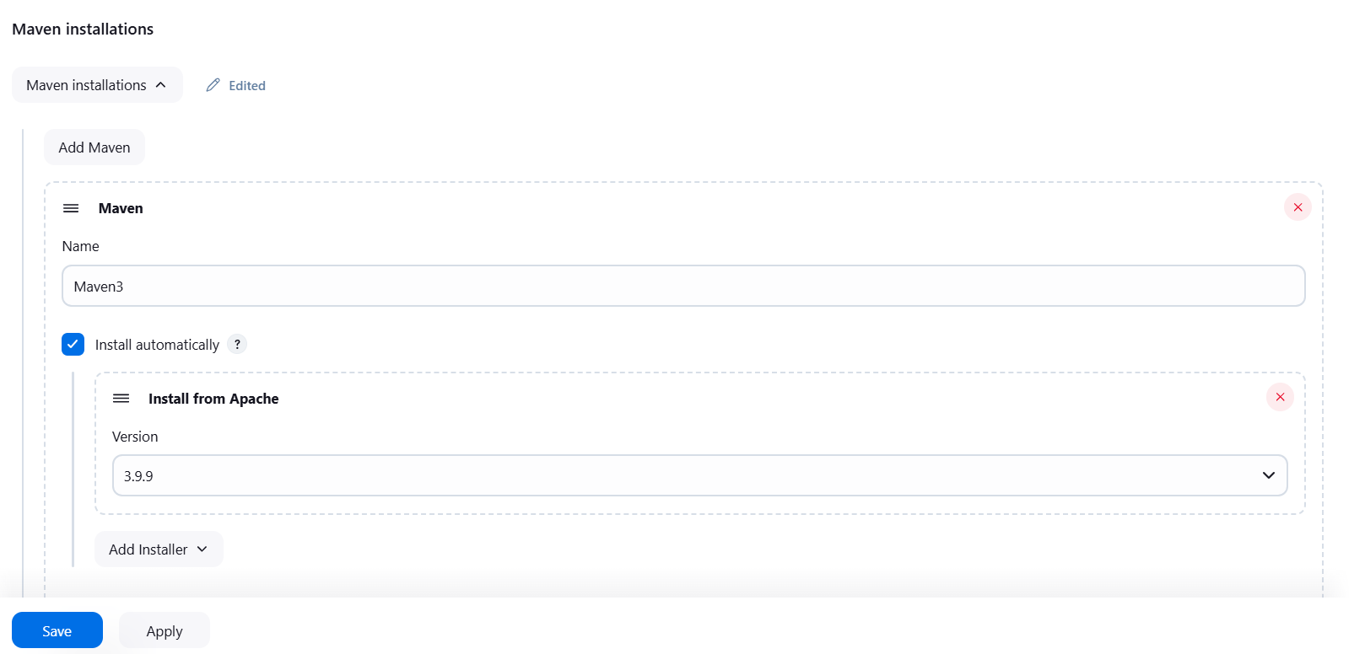
Reload system daemon files →sudo systemctl daemon-reload Restart Docker service as well →sudo service docker stop →sudo service docker start Create Maven Variable under Global and credentials in Jenkins dashboard:- Add the maven in tools Add the maven name and version (Latest version)

Slide 30
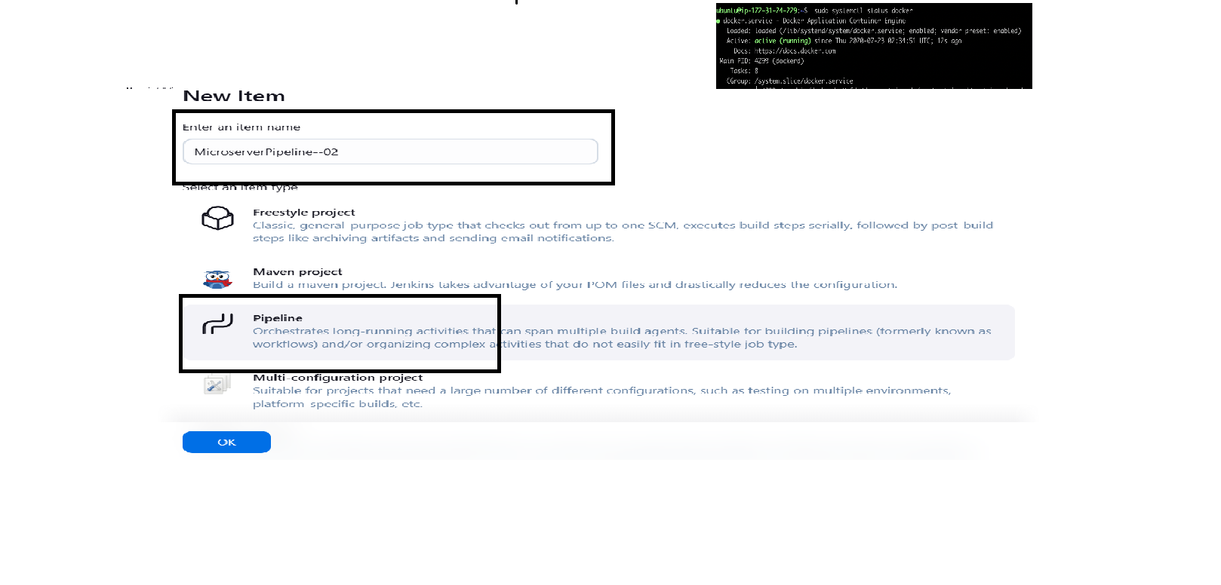
Now create a project in Jenkins dashboard → Select the new item and enter the name of the project → Select the Pipeline and click on OK

Slide 31
Select the pipeline script and enter the required pipeline data pipeline { agent any stages { stage('Checkout') { steps { checkout scmGit(branches: [[name: '*/main']], extensions: [], userRemoteConfigs: [[credentialsId: 'dockerhub_ID', url: 'https://github.com/sunildev03/MicroService-Core-Deploy.git']]) } } } } Click Apply and save then Build the code Pipeline

Slide 32
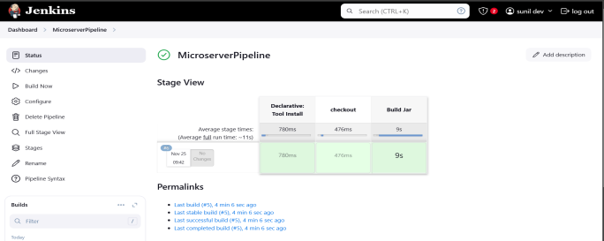
When Build get success it shows like below

Slide 33
Here the next stage is go back to the code and we have to add the jar files in the code so we have to configure the code to build the jar pipeline{ agent any tools { maven "Maven3" } stages { stage('checkout') { steps { checkout scmGit(branches: [[name: '*/main']], extensions: [], userRemoteConfigs: [[url: 'https://github.com/akannan1087/springboot-app.git']]) } } stage ('Build Jar') { steps { sh "mvn clean install" } } } }

Slide 34
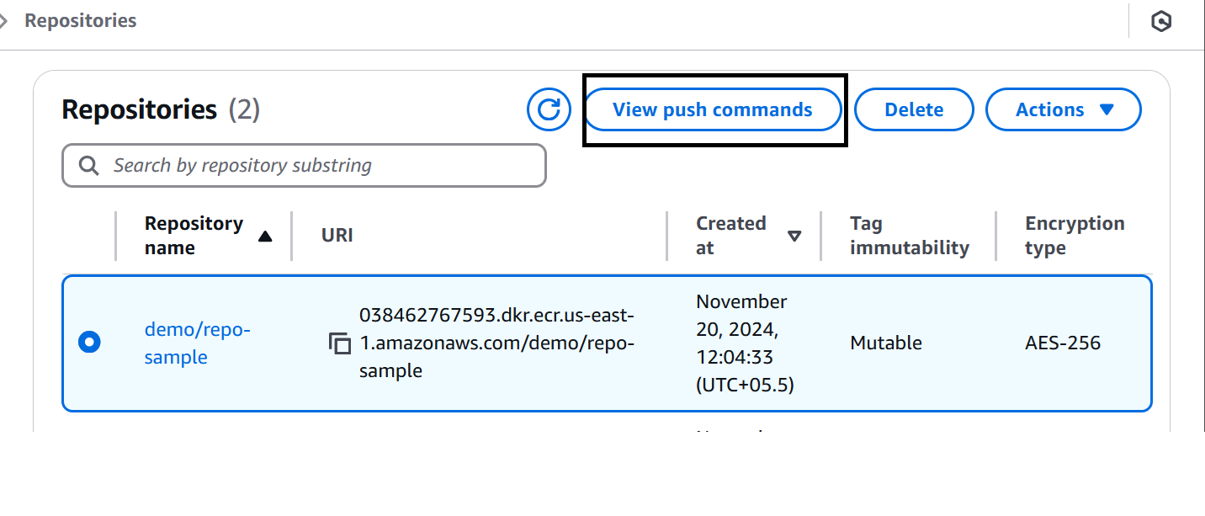
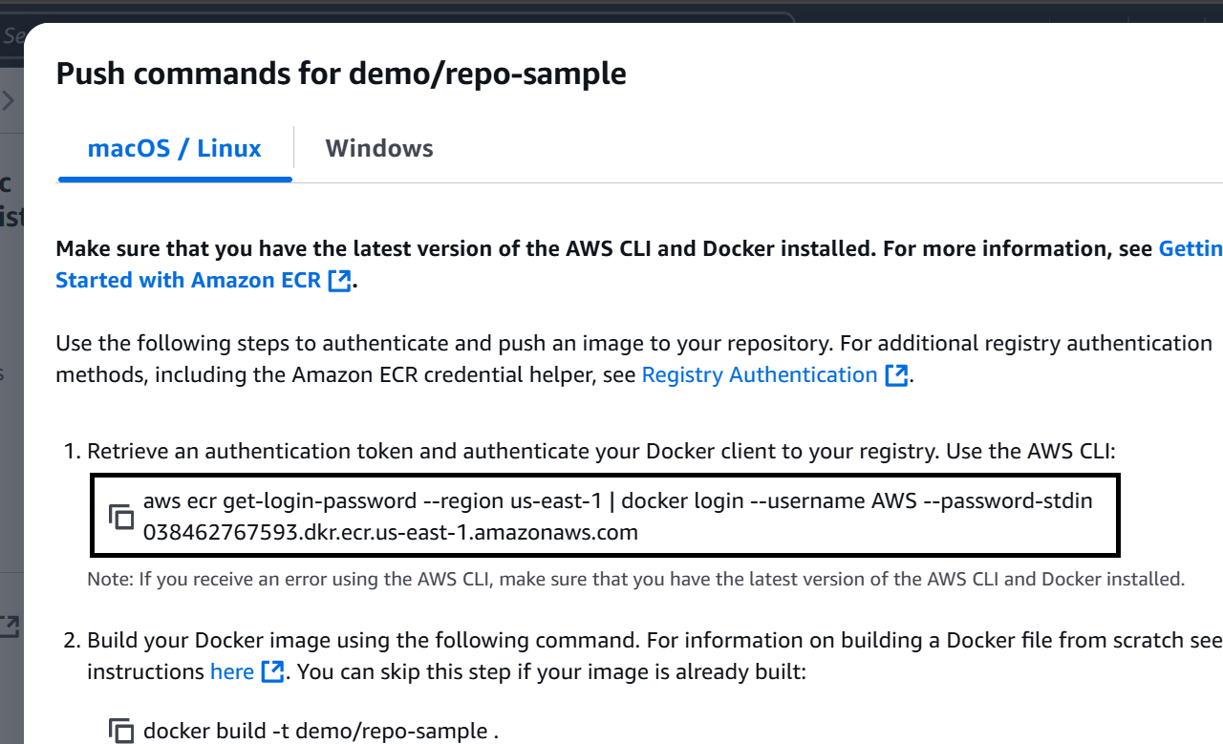
Now the next stage is we have to build the docker image:- Here we need to add the environment registry to the pipeline → To add the registry link search the ECR in Aws console and select the repository and open the view push commands Now copy the Docker registry link on the console

Slide 35
Now paste the URL in the pipeline to add the docker image pipeline{ agent any tools { maven "Maven3" } environment { registry = 038462767593.dkr.ecr.us-east-1.amazonaws.com/demo/repo-sample stages { stage('checkout') { steps { checkout scmGit(branches: [[name: '*/main']], extensions: [], userRemoteConfigs: [[url: 'https://github.com/akannan1087/springboot-app.git']]) } } stage ('Build Jar') { steps { sh "mvn clean install" } } stage ("Build Image") { steps { script { docker.build registry } } } } }

Slide 36
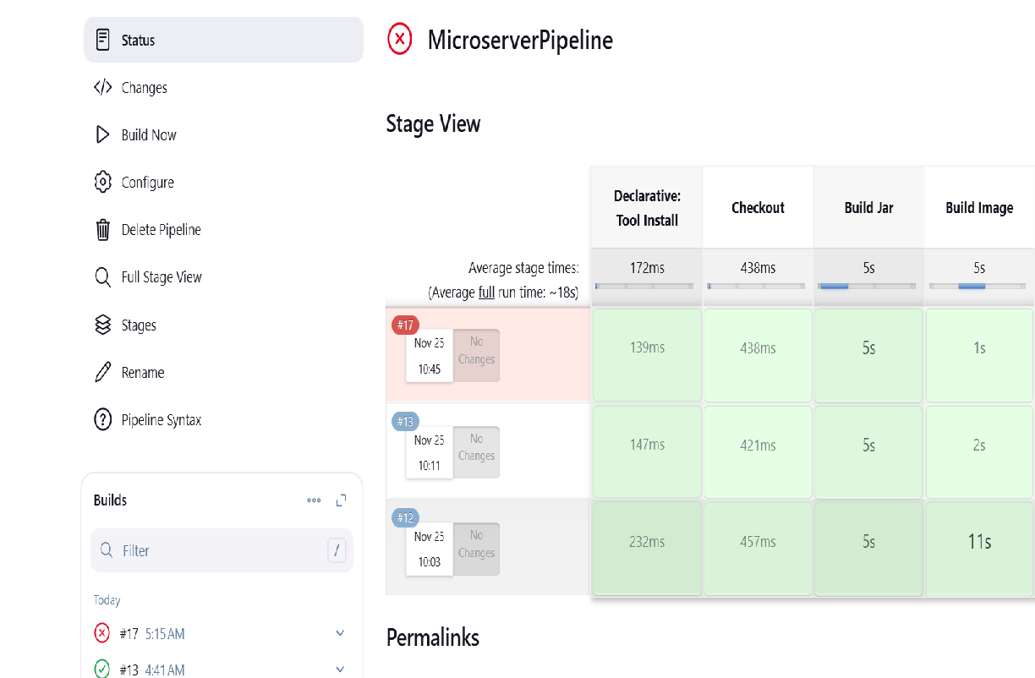
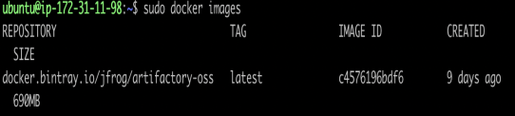
Click apply and save to build the pipeline Now check weather the docker image is created or not Now the another step is we have to push the docker image into ECR →Add the required pipeline data to push the docker image into ecr Cop →we can find the commands from the view push commands in ecr repository → Select the repository and open the view push commands then copy the required commands and paste the commands on the pipeline and run the pipeline

Slide 37
pipeline { agent any tools { maven "Maven3" } environment { registry = '038462767593.dkr.ecr.us-east-1.amazonaws.com/demo/repo-sample' } // Closing the environment block here stages { stage('Checkout') { steps { checkout scmGit(branches: [[name: '*/main']], extensions: [], userRemoteConfigs: [[url: 'https://github.com/akannan1087/springboot-app.git']]) } } stage('Build Jar') { steps { sh "mvn clean install" } }

Slide 38
stage('Build Image') { steps { script { docker.build(registry) } } } stage ("Push into ECR") { steps { sh "aws ecr get-login-password --region us-east-1 | docker login --username AWS --password-stdin 038462767593.dkr.ecr.us-east-1.amazonaws.com" sh "docker push 038462767593.dkr.ecr.us-east-1.amazonaws.com/demo/repo-sample:latest" stage("EKS Deploy"){ steps { withKubeConfig(caCertificate: '', clusterName: '', contextName: '', credentialsId: 'EKS', namespace: '', restrictKubeConfigAccess: false, serverUrl: '') { sh "kubectl apply -f eks-deploy-k8s.yaml" } } } stage } }

Slide 39
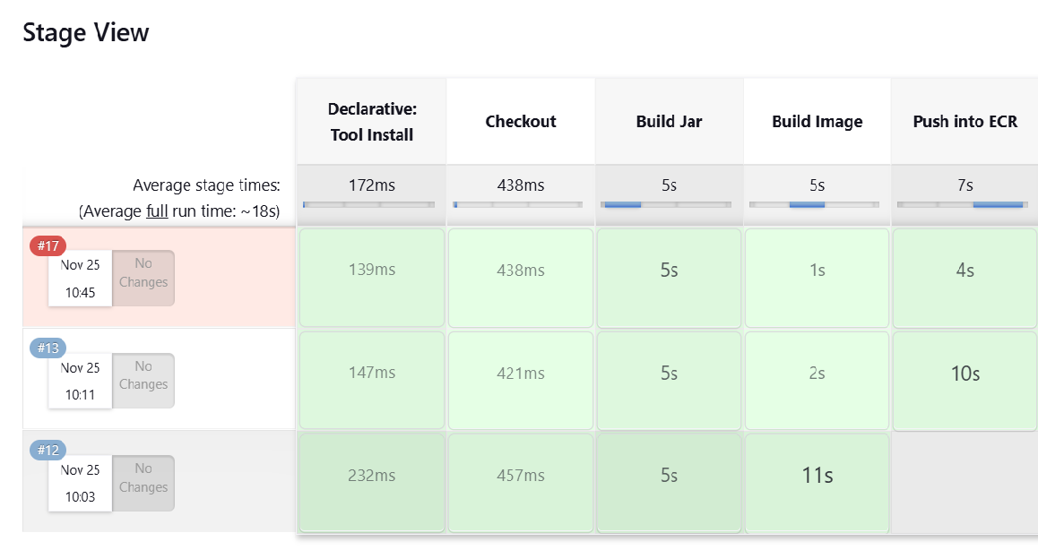
After the build got success the console output will be shown like below Now the last step is connecting to the cluster To check the cluster is running we use the command like eksctl get cluster --name demo-eks --region us-east-1 (cluster name and region should be add as per requirement)

Slide 40
Conclusion :
In conclusion, implementing auto-scaling policies for microservices is essential for ensuring that applications remain responsive, efficient, and cost-effective under varying loads. By defining clear scaling metrics, choosing appropriate scaling mechanisms, and leveraging tools like container orchestration (e.g., Kubernetes), organizations can achieve seamless scalability without manual intervention. Auto-scaling helps maintain optimal resource utilization, improves system reliability, and supports fault tolerance, while minimizing costs by only scaling when necessary. With the right policies and monitoring in place, businesses can ensure their microservices architecture is agile, scalable, and able to handle dynamic traffic demands effectively.

Slide 41


